Slide 1
Thesis Advisory Committee Meeting October 28, 2019
Vincent Baker
Drexel University Department of Physics

Slide 2
Thesis Plan
Started Fall 2014, passed written exam Fall 2015, passed oral exam June 2018
Goal is to defend Fall 2020, reality may be Spring 2021
Summer 17-18
Fall 18-19
Winter 18-19
Spring 18-19
Summer 18-19
Fall 19-20
Winter 19-20
Spring 19-20
Summer 19-20
Fall 20-21
Oral exam
TAC meeting
TAC meeting
Thesis defense
Paper #1: Dynamics of traveling waves in a column
Write thesis
Paper #2: Machine learning using ensembles of columns

Slide 3
Research overview
Research question: What are the dynamics of traveling waves in “1-D” neural structures and what are there possible cognitive functions?
Research approach:
Simulate 1-D neural structures and study how topology, connectivity, neuron/synapse dynamics determine the formation and properties of traveling waves (complete)
Examine connected ensembles of 1-D structures (partially complete)
Place these simulated neural structures in a framework

Slide 4
Impact
As brain imaging spatial and temporal resolution has improved, mesoscale traveling waves have been observed
One explanation for how the order of cognition evolves from the chaos of individual neuron activity
Various models for wave behavior including local connectivity, sequential time delay and coupled oscillators
Some general principles for computational role of traveling waves
What’s our contribution?
Exhaustive exploration of traveling wave dynamics in 1-D neural structures (previous work in 2-D “sheets”)
Examination of traveling wave computational role using an artificial intelligence framework

Slide 5
Background
Neurons
Cortex organization
Layers w/ column penetrations
Waves in the cortex
Mesoscale

Slide 6
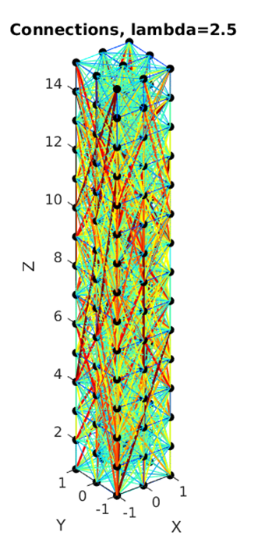
Column Structure
Topology: cross section (length x width), height
Connectivity: Long vs. short range, connection density
Neuron/synapse dynamics: dynamic system with two dimensions (Izhikevich model)

Slide 7
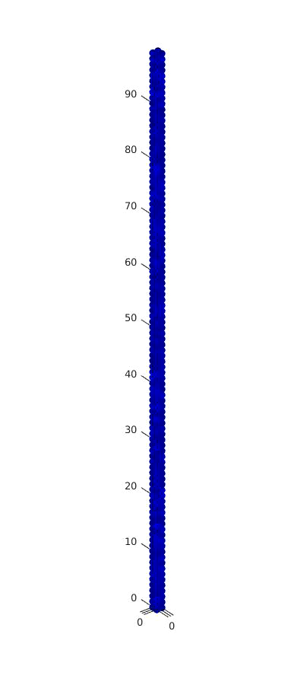

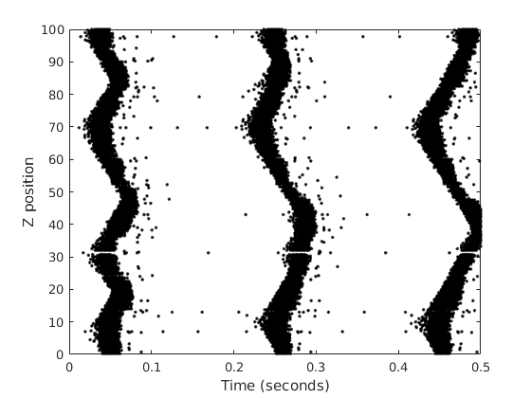
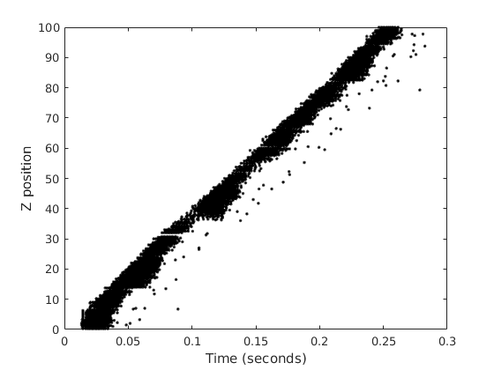
Traveling waves in columns
Uniform random stimulus
Step stimulus to bottom 5 layers

Slide 8
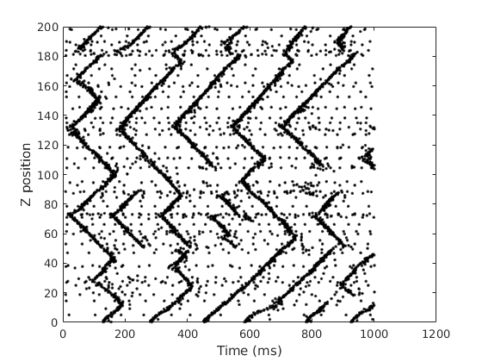
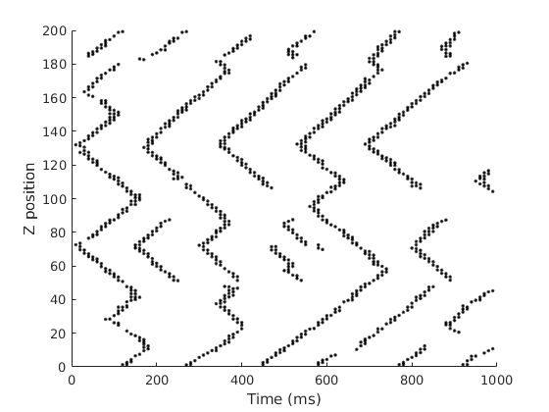
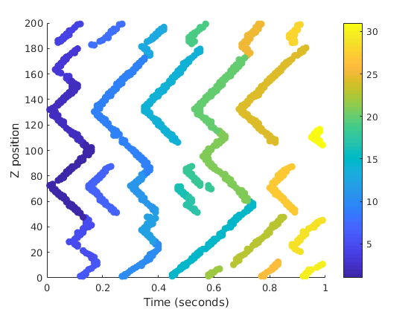
Wave detection and labeling
Need to determine wave properties, requires detection and labeling
Method: apply a density filter to remove background firing events, then use a plane sweep algorithm to label the waves
Raw firing events
Density filter
Labeled waves

Slide 9
Wave initiation

Slide 10
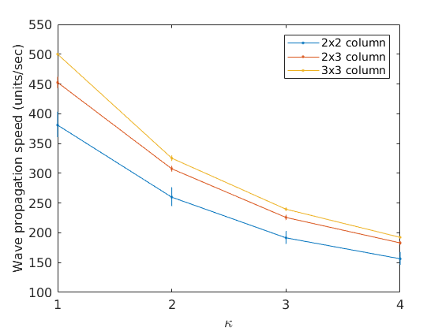
Wave velocity
Wave speed depends on action potential delay, but it’s not linear
Thicker columns support faster waves

Slide 11
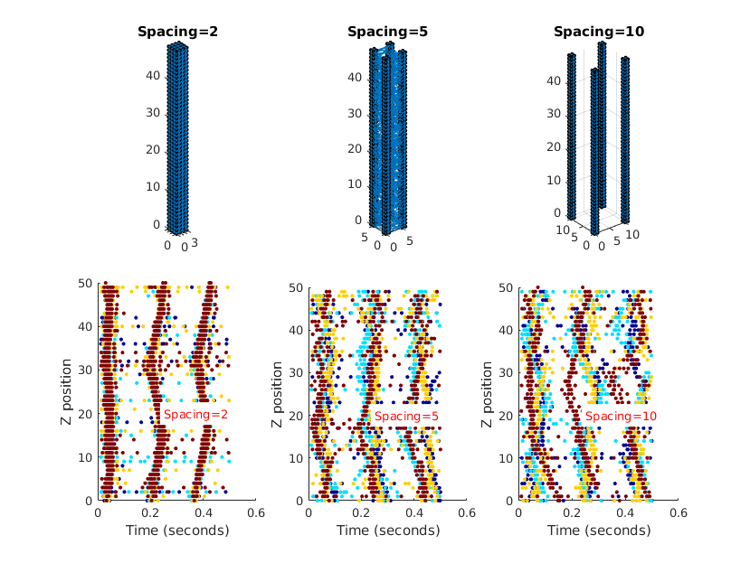
Ensembles of columns
Explore multiple 1-D structures with different levels of connectivity
With high connectivity, ensemble responds like a single large column
With no connectivity columns are independent
Weak connectivity: coupling between columns creates interesting dynamics

Slide 12
Ensemble periodic response

Slide 13
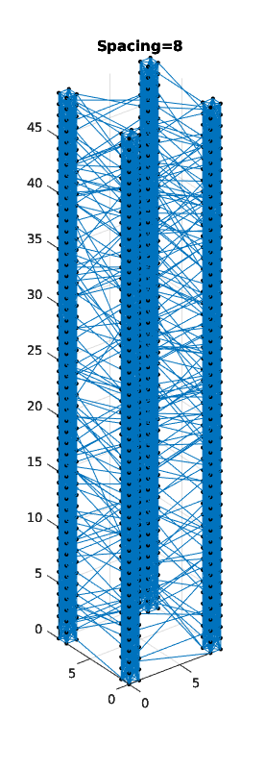
Column ensemble
Ensemble of 4 columns
Each constituent column is 4x4x50
Columns spaced 8 units apart
Strongly connected columns, weak interconnections
Stimulated bottom 4 layers with sine input

Slide 14
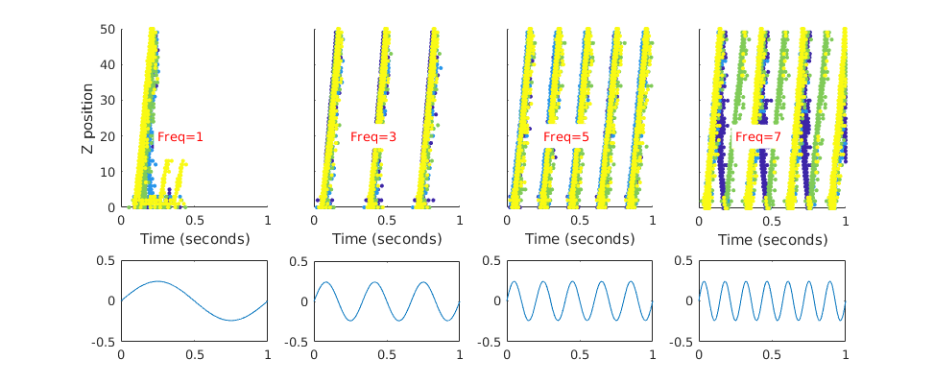
Frequency dependence
At very low frequencies each cycle can produce one or multiple waves
At medium frequencies each cycle produces one wave
At high frequencies output is complex
Firing diagram, color-coded by column
Stimulus

Slide 15
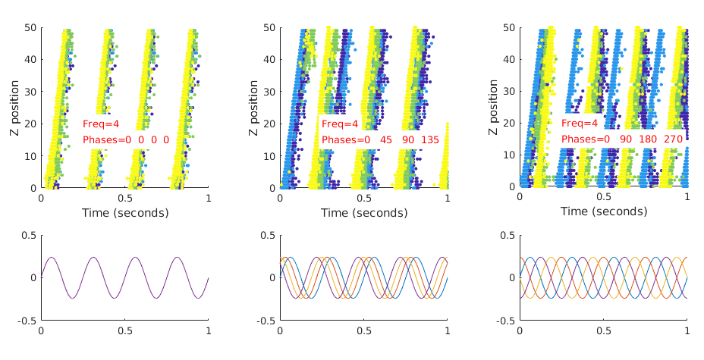
Phase dependence
Changed the phase of the stimulus to each column
Ensemble tends to aggregate response if stimulus is close to in-phase, complex response when stimulus is out of phase
Firing diagram, color-coded by column
Stimulus, colord-coded by column

Slide 16
Next steps
Characterize column ensembles as coupled oscillators
Train a classifier based on ensemble of columns, measure classification performance as a function of column parameters (paper #2)
Develop thesis from papers 1 and 2

Slide 17
References
[1] S. V. Buldyren et al. “Description of microcolumnar ensembles in association cortex and their disruption in Alzheimer and Lewy body dementias".
In: Proceedings of the National Academy of Sciences, 97.10 (2000).
[2] Izhikevich MATLAB simulation. url: https://www.izhikevich.org/publications/net.m.
[3] E. Izhikevich. “Simple Model of Spiking Neuron". In: IEEE Transactions on Neural Networks 14 (2003).
[4] Eugene Izhikevich. Dynamical Systems in Neuroscience. MIT Press, 2007.
[5] Adam Keane and Pulin Gong. “Propagating Waves Can Explain Irregular Neural Dynamics". In: Journal of Neuroscience 35.4 (2015).
[6] Thomas Kreuz et al. “Monitoring spike train synchrony". In: Journal of Neurophysiology 109 (2012).
[7] Wolfgang Maas and Henry Markram. “Real-time Computing Without Stable States: A New Framework for Neural Computation Based on Perturbations".
In: Neural Computation 14 (2002).
[8] Henry Markram, Yun Wang, and Misha Tsodyks. “Differential signaling via the same axon of neocortical pyramidal neurons".
In: Proceedings of the National Academy of Sciences, 95 (1998).
[9] The p-delta rule for parallel perceptrons. url: http://www.igi.TUGraz.at/maass/p%20delta%20learning.pdf.
[10] Y. Zhang et al. “A Digital Liquid State Machine With Biologically Inspired Learning and Its Application to Speech Recognition".
In: IEEE Transactions on Neural Networks and Learning Systems 26.11 (2015).

